Slide 1
CSCE 4350 Class Project
By Michael Moore

Slide 2
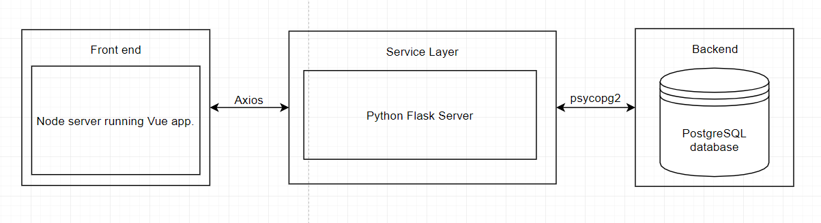
The Design
For this project I decided to make a storefront. I made the front end with vue.js, the service layer with python, and Postgresql as my backend database.
A visual Representation of my codebase:

Slide 3
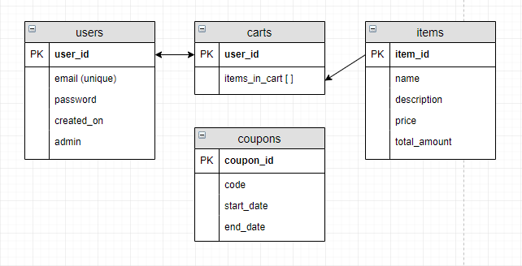
The Design Cont.
Database Scheme:

Slide 4
Why A Storefront?
By making a storefront, I am able to interact with the database in many different forms:
Retrieve data such as items/users/coupons/carts from the database.
Insert new data in the form of new users/items/coupons.
Update data such as carts.

Slide 5
Interacting With Data: Retrieving
Retrieving Items from the database:
This was a simple but extremely important query. This allowed items to be visible on our store.
“ SELECT item_id, name, price, description, total_amount FROM items; ”
Retrieving user data from the database:
Users are allowed to make accounts on our website, so I needed to make a way to pull their account information from the database.
“ SELECT User_id, email, password FROM users WHERE email = ~user_entered_email~ ; ”

Slide 6
Interacting With Data: Retrieving Cont.
Retrieving a user’s cart data from the database:
Along with a user account, user’s carts are automatically saved to the store. When they log in, the cart on the store will be replaced with the saved cart in the store.
“
WITH counts as (
SELECT item, count(*)
FROM carts, UNNEST(items_in_cart) as item
WHERE user_id = ~current_user_id~ GROUP BY item
)
SELECT item_id, name, price, description, total_amount, count
FROM items, counts, carts
WHERE carts.user_id = ~current_user_id~ AND counts.item = item_id;
”

Slide 7
Interacting With Data: Retrieving Cont.
Retrieving coupon data from the database:
This allowed users to apply coupons in the store.
“ SELECT coupon_id, code, end_date FROM coupons; ”

Slide 8
Interacting With Data: Inserting
Inserting a new user account and cart into the database:
In order to insure that every user has a cart, I decided to make a function that makes a new user and cart at the same time. In order to accomplish this I decided to use the plpython3u language extension in PostgreSQL which allowed me to make a database function in python.
Function:
INSERT INTO users(email, password, admin) VALUES( ~email_given~, ~password_given~, ~admin_given~)
INSERT INTO carts(user_id) SELECT user_id FROM users WHERE email = ~email_given~

Slide 9
Interacting With Data: Inserting Cont.
Inserting a coupon into the database:
This is what allows admin users to insert coupons for other people to use.
“ INSERT INTO coupons(code,end_date) VALUES(~code_given~, TO_TIMESTAMP(~date_given~, 'YYYY-MM-DD' ) ); “
Inserting new items into the database:
This is what allowed admins to add items to the site.
“INSERT INTO items( name, description, price, total_amount ) VALUES(~item_name_given~, ~item_desc_given~, ~price_given~, ~quantity_given~); ”

Slide 10
Interacting With Data: Updating
Updating items in the user’s cart in the database:
For convenience, I save what the user adds to their cart to the database. This allows them to come back to the store and continue their shopping at a later date.
“ UPDATE carts SET items_in_cart = array_append( items_in_cart ,~item_id_given~ ) WHERE user_id = ~user_id_given~ ; ”
Updating item amounts in the database when items are bought:
The main objective of a store is to sell things. To accomplish this, when the user buys items we update the quantity of our items to reflect the change.
“ UPDATE items SET total_amount = (~New_total_amount_given~) WHERE item_id = ~item_id_given~ ; “

Slide 11
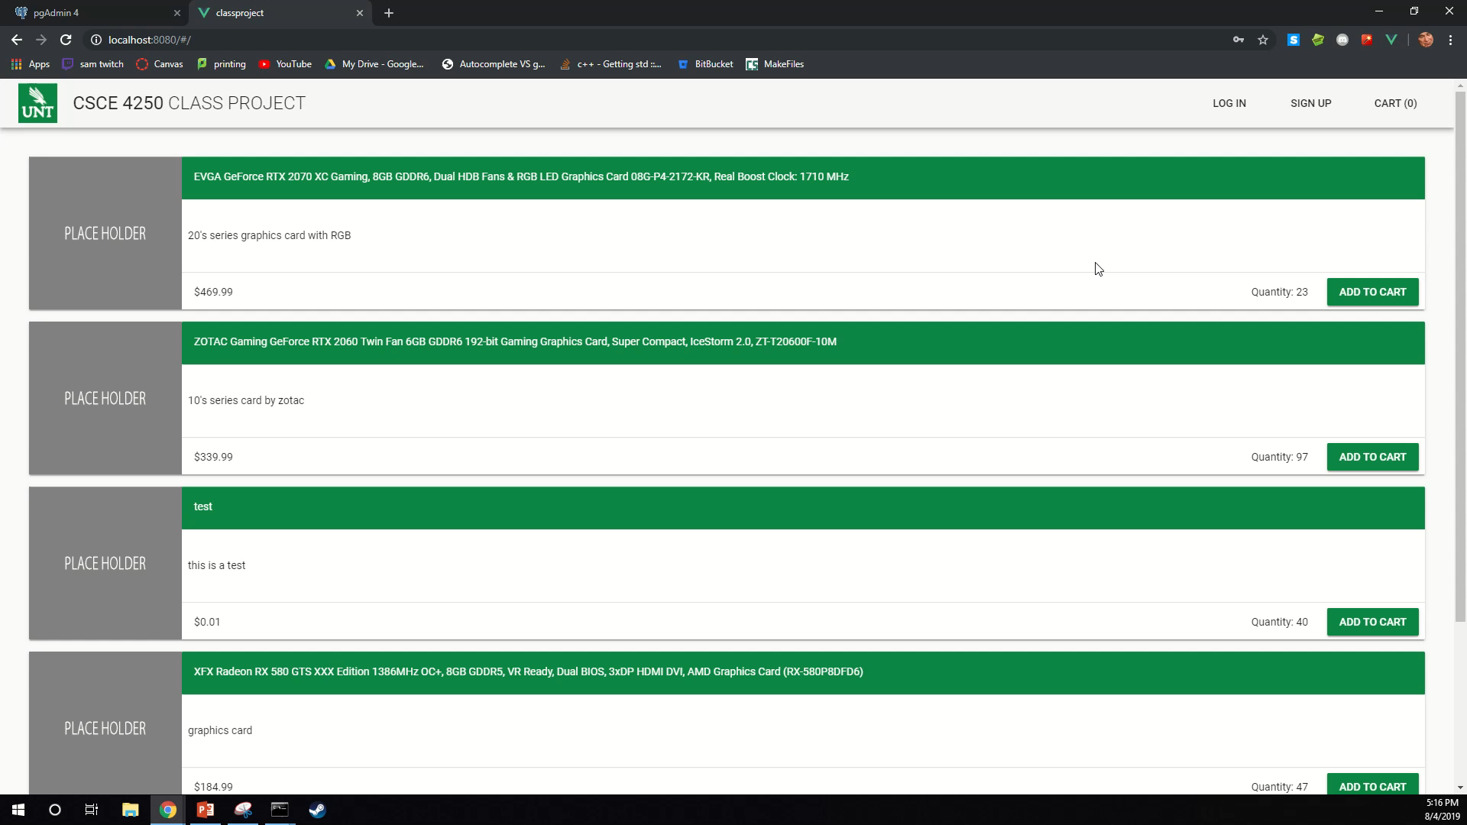
Demo:

Slide 12
One Interesting Find
PostgreSQL and Arrays:
PostgreSQL has a function to add one thing to an array ( array_append() )
PostgreSQL doesn’t have a function to remove one item from its array however.
This was an issue when I was trying to make a function to delete items from a user’s cart.
Solution?
Make a new array to match the cart in my service layer, remove the item via pythons array.remove() function, then set the cart to equal the new array.

Slide 13
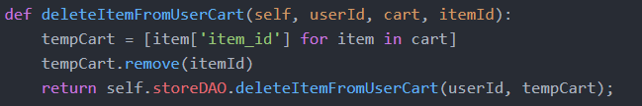
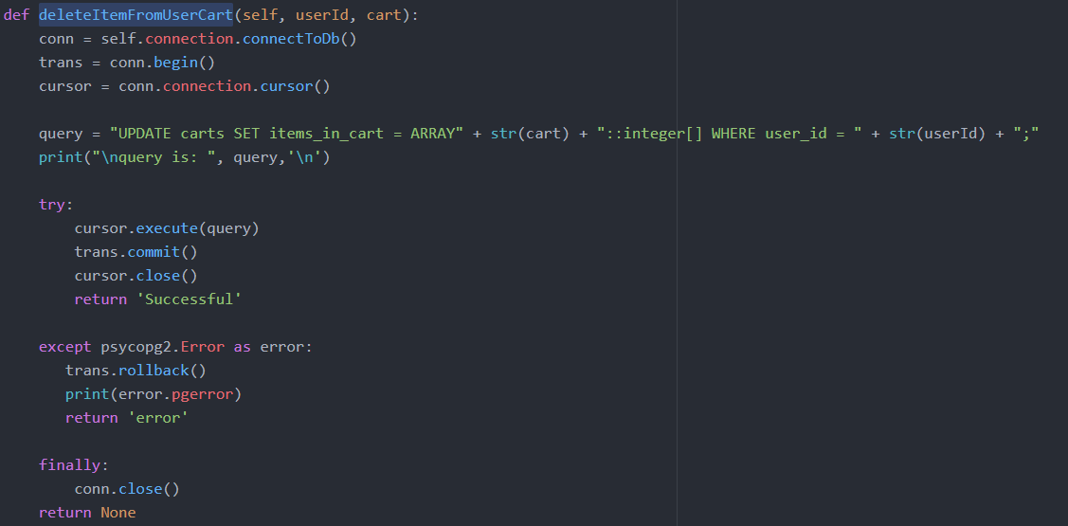
One Interesting Find Cont.

Slide 14
Thanks.

